Slide 1

Project Title -Healthcare Analytics for Doctor Visits
Student Name : Dipika Dnyaneshwar Patil
College Name : Yashwantrao Bhonsale Institute of Technology
AICTE STU ID : STU69faca05197bf1778043397

Slide 2

PROBLEM STATEMENT
Healthcare data contains information about patients, their demographic characteristics, health conditions, and healthcare utilization. However, raw healthcare data does not clearly show how doctor visits vary across different patient characteristics.
The problem is to analyze the given healthcare dataset and investigate patterns in doctor visits by examining gender, age, illness level, and other available health-related variables. The analysis aims to identify meaningful distributions, relationships, and variations within the available data.

Slide 3
Project Description
Healthcare Analytics for Doctor Visits is a data analytics project that studies patterns in recorded doctor visits using a healthcare dataset.
The dataset contains 5,190 records and 13 variables, including doctor visits, gender, age, income, illness, reduced activity, health, insurance-related indicators, and chronic-condition indicators.
The project begins with data exploration using the first and last records, dataset dimensions, information about variables, descriptive statistics, and missing-value analysis.
The project then performs univariate and multivariate analysis using different visualizations. The analysis examines gender distribution, age distribution, doctor visit distribution, average visits by gender, illness score versus average visits, visits by gender, and the relationship between age, visits, and gender.

Slide 4

WHO ARE THE END USERS?
Healthcare Analysts – to understand patterns and relationships in doctor visit data.
Healthcare Researchers – to study relationships between patient characteristics, illness, and healthcare utilization.
Healthcare Providers – to understand variations in recorded doctor visits across patient groups.
Healthcare Planners and Organizations – to examine healthcare utilization patterns for planning and analysis.
Students and Data Analysts – to learn and demonstrate exploratory data analysis using healthcare data.

Slide 5

Technology Used
Python – for data analysis and processing.
Google Colab / Jupyter Notebook – for running the analysis.
Pandas & NumPy – for data loading, inspection, manipulation, and statistical analysis.
Matplotlib & Seaborn – for creating data visualizations.
CSV – for storing and accessing the healthcare dataset.
GitHub – for project code and version control

Slide 6
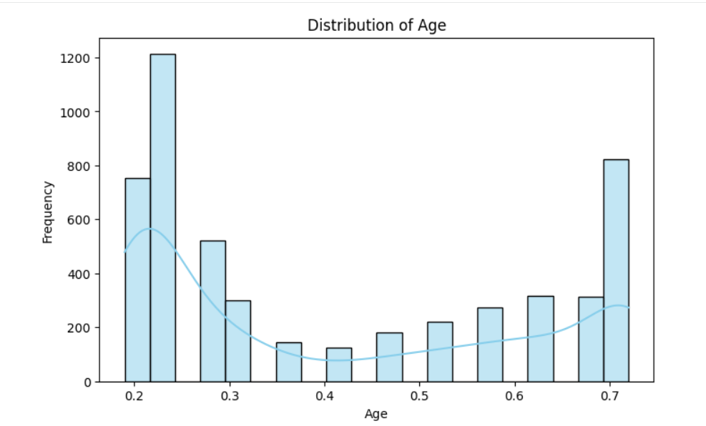
RESULTS
Age Distribution
This graph shows the distribution of the numerical age variable in the healthcare dataset. It helps us understand how the age values are distributed across the available records.

Slide 7
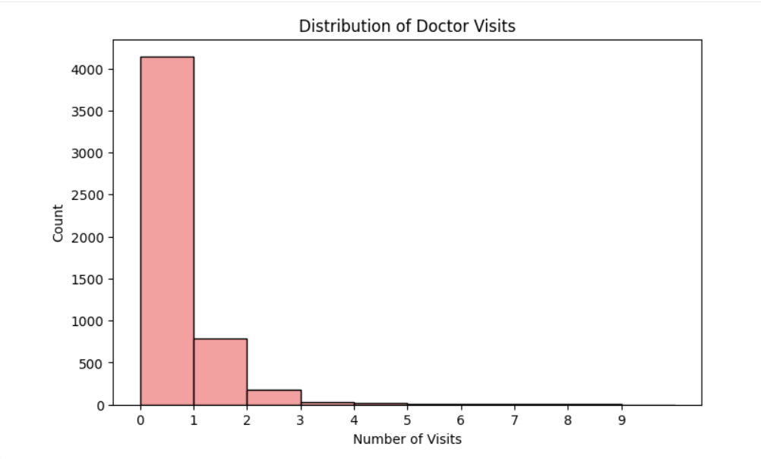
RESULTS
Doctor Visits Distribution
This graph shows how the number of recorded doctor visits is distributed across the dataset. It helps us understand the frequency of different visit counts.
The recorded visits range from 0 to 9, with an overall mean of approximately 0.302 visits.

Slide 8
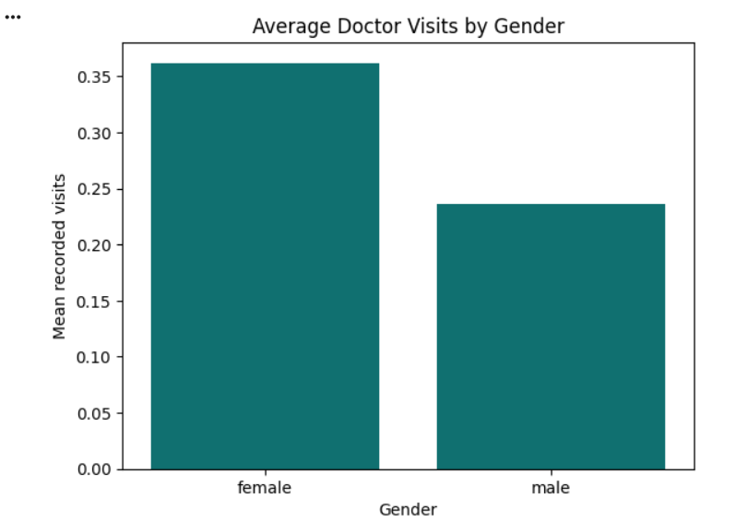
RESULTS
Average Doctor Visits by Gender
This graph compares the average recorded doctor visits between female and male patients. It helps identify differences in the mean number of visits between the two gender groups.

Slide 9
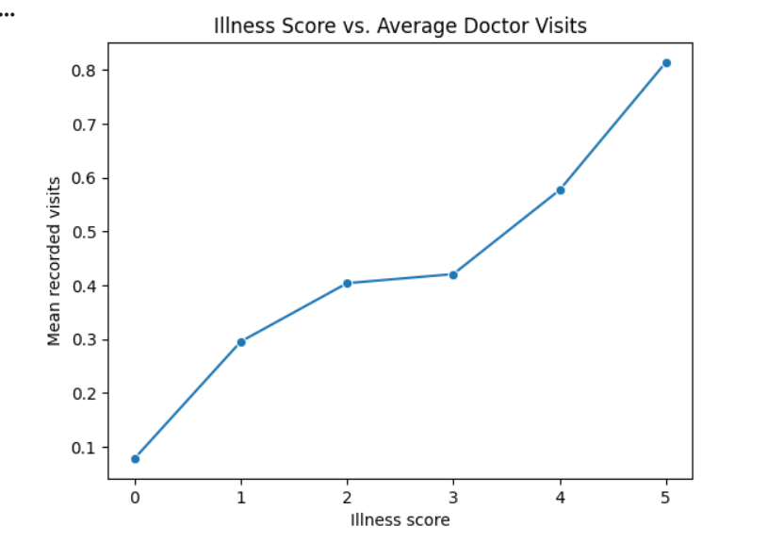
RESULTS
Illness Score vs. Average Doctor Visits
This graph compares the average number of recorded doctor visits across different illness-score groups. It helps examine how recorded visits vary as the illness score changes.

Slide 10
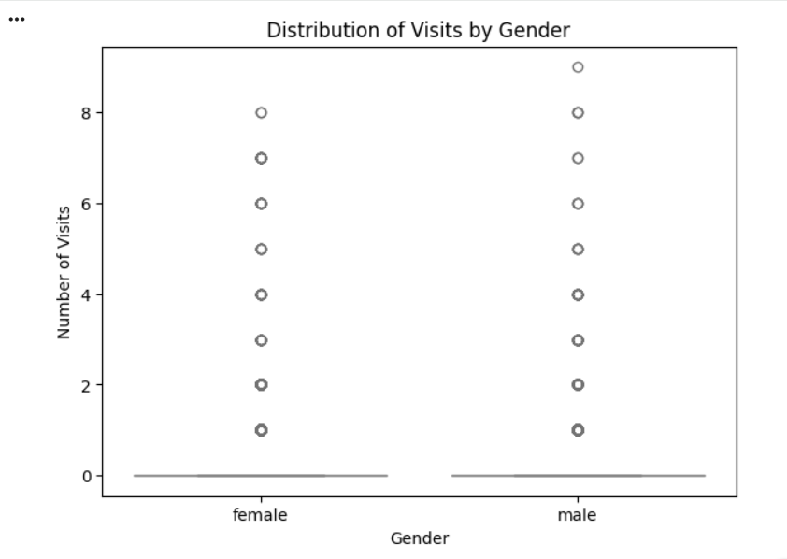
RESULTS
Distribution of Visits by Gender
This box plot compares the distribution of recorded doctor visits between female and male patients. It provides a visual representation of the spread, central tendency, and variation of visits within each gender group.

Slide 11
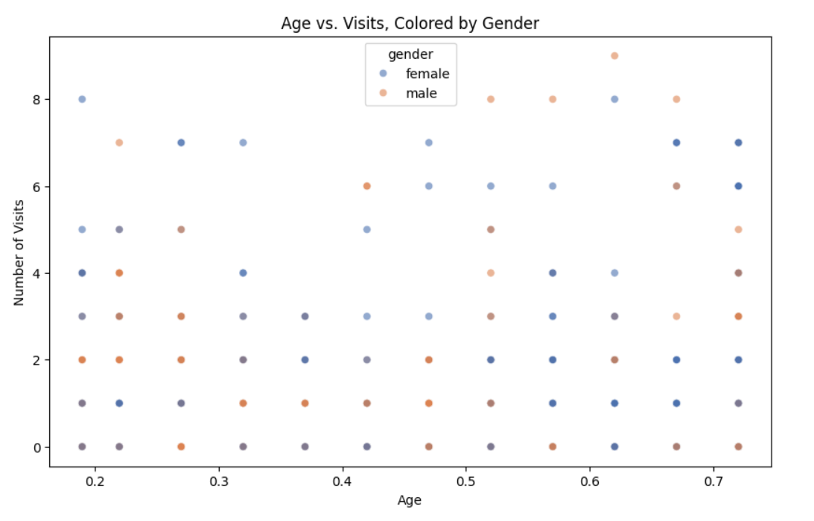
RESULTS
Age vs. Visits, Colored by Gender
It helps visualize how doctor visits are distributed across age values and allows the patterns of the two gender groups to be viewed together.

Slide 12
Future scope
Develop a predictive model to forecast doctor visit frequency.
Include additional healthcare and demographic variables for deeper analysis.
Build an interactive healthcare analytics dashboard.
Perform statistical tests to examine relationships between variables.
Apply machine learning techniques for healthcare utilization prediction.
Expand the analysis using larger and more diverse healthcare datasets.
Analyze chronic conditions and healthcare service usage in greater detail.

Slide 13
GitHub Link
https://github.com/dipikapatil25/Healthcare-Analytics-for-Doctor-Visits.git

Slide 14
Thank you
.
.

